Slide 1

Reading aloud
Every child’s basic need and a very rewarding investment
Research results on the value of reading aloud for the future of children
Read to children | Goethe Institut & Lukukeskus | Helsinki January 24, 2018 | Dr. Simone C. Ehmig

Slide 2
Why do we need campaigns to promote reading aloud?

Slide 3
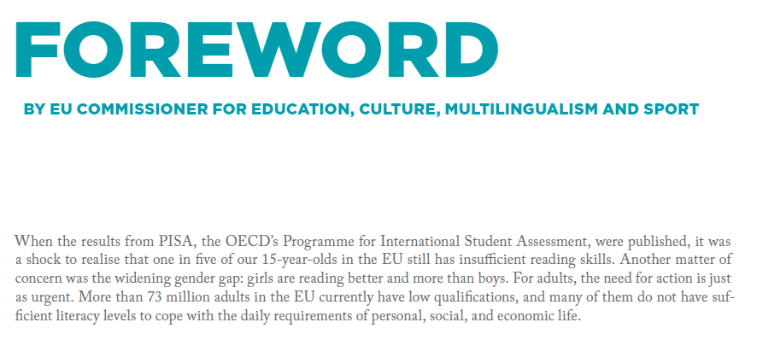
Is Europe a continent of (il)literates?
EU High Level Group of Experts 2012
Source: EU High Level Group of Experts On Literacy (2012): Final Report, page 9
http://ec.europa.eu/dgs/education_culture/repository/education/policy/school/doc/literacy-report_en.pdf (12 January 2018).
Page 3
Notes:
Page 39

Slide 4
Low performance in literacy – A “renewable“ problem in most European countries
Percentage of low performers
in reading among
Page 4
Notes:
Page 39

Slide 5
Vicious circle: Education opportunities depend on the
level of education achieved by parents
Percentage of young adults between the ages of 18 and 35 whose fathers have achieved different levels of education
Reading ability of adults between the ages of 18-35:
Father‘s level of education
Source: leo. Level-One-Studie 2011.
Page 5

Slide 6
Many adults with poor reading skills have children
Example: Germany
Percentage of households in which children and adolescents live
Source: leo. Level-One-Studie 2011.
Page 6

Slide 7
Many adults with poor reading skills have children
Example: Germany
Percentage of households in which children and adolescents live
... Looked at differently:
In 16.2 percent of families with children between the ages of 0 and 13, at least one parent has problems with reading and writing.
Source: leo. Level-One-Studie 2011.
Page 6

Slide 8
In households with young adults who are poor readers
there are not many reading materials
Percentage of households with young adults between the ages of 16 and 35 with different numbers of books
Reading ability according to PIAAC
Page 8

Slide 9
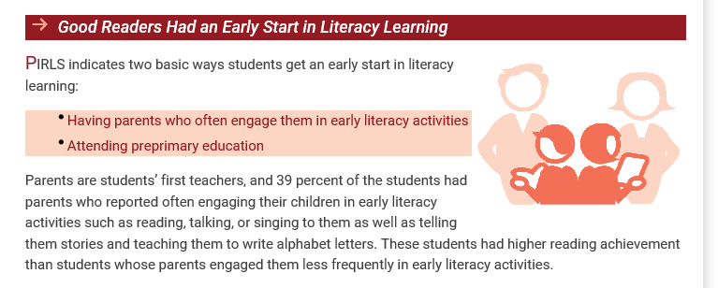
Early intervention in families is key as recently confirmed by PIRLS
Source: PIRLS 2016 International Results in Reading
http://timssandpirls.bc.edu/pirls2016/international-results/pirls/summary/ (12 January 2018).
Page 9
Notes:
Page 39

Slide 10
Reading aloud and promoting reading early on –
Escaping the vicious circle

Slide 11
Children who were read to earn better grades – not just in German
Question for children (n=524): “Please tell me the grade you earned on your last report card for each subject.“ | Average grades
1st Foreign
language**
General Studies /
Biology**
The groups differ in a statistically significant way
* p < 0.05
**p < 0.01
Children ages 8 to 12 whose parents …
Source: German Reading Foundation | 2015 Reading Aloud Study
Page 11

Slide 12
The differences in school grades are independent of educational background
Question for the children (n=524): “Please tell me the grade you earned on your last report card for each subject.“|
Grade 1 and 2 | Numbers given in percent
Indicator: The grade for German in the last report card was 1 or 2
(n= 52)
(n= 88)
(n= 50)
(n= 52)
(n=100)
(n= 60)
(n= 30)
(n= 43)
(n= 44)
Children ages 8 to 12 whose parents ...
Source: German Reading Foundation | 2015 Reading Aloud Study
Page 12

Slide 13
Reading aloud is important for reading enjoyment –
Indicator reading a book
Respondents (in %) who say
“Reading a book is fun“
+16 %
Respondents (in %) who read
in a book at least once a week
+10 %
Average time spent reading a book on a weekday (Mon.- Fri.)
45,9 min
33,9 min
+12 min.
Children and adolescents between the ages of 10-19 who …
Source: German Reading Foundation | 2011 Reading Aloud Study
Page 13

Slide 14
Reading aloud increases reading enjoyment - particularly for boys
Respondents who say
“Reading a book is fun“ (in %)
Boys
+20 %
Respondents who read in a book
at least once a week (in %)
Average time spent reading a book on a weekday (Mon.- Fri.)
Boys who ...
Respondents who say
“Reading a book is fun“ (in %)
Girls
+ 9 %
Respondents who read in a book
at least once a week (in %)
Average time spent reading a book on a weekday (Mon.- Fri.)
min
Girls who ...
Source: German Reading Foundation | 2011 Reading Aloud Study
Page 14

Slide 15
Adolescents with an affinity for reading really see the value of reading
Adolescents in comprehensive schools (Gesamtschule) at the level of a general school (Hauptschule)
Reading …
Good readers vs.
Poor readers
makes you smart
is helpful to me later in life
is a good way to relax
is excitung
is entertaining
is cool
is boring
is exhausting
is a waste of time
Is what keeners do
is out
makes you lonely
Poor readers
Good readers
“Strongly agree “
“Strongly disagree“
Source: German Reading Foudnation: Zeitschriftenlektüre und Diversität. Mainz 2011.
Page 15

Slide 16
Reading aloud is important for reading enjoyment into adulthood
Adults say …
+25 %
+19 %
+18 %
+19 %
- 12 %
Adults who were read to often as small children (n=524)
Adults who were read to now and then, seldom, or never (n=1,436)
Source: German Reading Foundation: Lesesozialisation in der Familie. Representative survey of 1,960 individuals 2010
Page 16

Slide 17
Reading aloud in childhood prevents a drop in reading levels in puberty
Percentage of children and adolescents between the ages of 10 and 19 who say “Reading a book is fun“ (in %)
- 7 % points
- 8 % points
- 3 % points
-11 %
points
relative loss: 9 %
relative loss: 24 %
Children and adolescents who were read to
Children and adolescents who were not read to
Source: German Reading Foundation | 2011 Reading Aloud Study
Page 17

Slide 18
Children who were read to benefit when it comes to the development of their personality
Question for mothers (n=524): “How would you describe your child? Which of the following characteristics applies to your child?“ |
Points 4 and 5 on a scale of 1: “strongly disagree “ to 5: “strongly agree “| Numbers given in percent
Children between the ages of 8 and 12
whose prarents …
Source: German Reading Foundation | 2015 Reading Aloud Study
Page 18

Slide 19
Social behavior of children who were read to creates a win-win situation
Question for mothers (n=524): “I am going to read a few excerpts from other parents who have children similar in age to yours. Which of these applies to ... ? Tell me with the help of this list.“ | Mothers who respond with “I experience this often, happens often“ and “I sometimes experience this“| Numbers given in percent
The environment clearly benefits from the involvement of children who were read to…
… and children benefit from what their environment gives back to them.
Children between the ages of 8 and 12
who were...
Source: German Reading Foundation | 2015 Reading Aloud Study
Page 19

Slide 20
Children who were read to show social responsibility
Question: I am going to read a few excerpts from other parents who have children similar in age to yours. Which of these applies to ... ? Basis: Surveyed mothers (n=524) | On a scale of 4 in % whereby 1: doesn‘t happen / 4: I experience this often, happens often.
My child …
Children between the ages of 8 and 12
who were …
Source: German Reading Foundation | 2015 Reading Aloud Study
Page 20

Slide 21
Parents recognize that reading aloud has benefits for their family
Question: “I am going to read a few statements about reading aloud in family life. Please indicate whether or not these statements apply to you.“
Mothers or fathers who read often or now and then to their child (n=431) | Number of those surveyed who respond with “applies“| in %
Source: German Reading Foundation | 2014 Reading Aloud Study
Page 21

Slide 22
What makes reading aloud as a preventative way to promote reading succeed over the long term?
Factors which make reading early on important are ...
Language input ⇒ Vocabulary, expressiveness
Contents, stories ⇒ Role and behavioral models, world knowledge
Regularity, routine ⇒ Reading becomes a part of life
Closeness to familiar people ⇒ Bond
Positive emotional experience ⇒ Safe space
Individual attention to the children strengthens and complements
the efforts involved in promoting language and reading.
Reading aloud ensures this ideally!
Page 22

Slide 23
Children love being read to even in households with a lower level of education
Questions asked of children whose parents read/have read to them (n=491): ”Do you sometimes not really enjoy being read to? / How often do/did you not really enjoy being read to?“ | Numbers given in percent
Percentage of children who …
Source: German Reading Foundation | 2016 Reading Aloud Study
Page 23

Slide 24
Children love being read to especially when this happens regularly
Questions for children whose parents read/have read to them (n=491): ”Do you sometimes not really enjoy being read to? / How often do/did you not really enjoy being read to?“ | Numbers given in percent
Percentage of children who …
Source: German Reading Foundation | 2016 Reading Aloud Study
estudie 2016.
Page 24

Slide 25
Children who are read to by their parents really want to be read to
Question for children who were/are read to by parents (n=491): “What do you want when being read to? What could be done better when being read to?“ | Numbers given in percent
Reading aloud frequency:
Source: German Reading Foundation | 2016 Reading Aloud Study
Page 25

Slide 26
Reading aloud and promoting reading early on –
Not a given for children in many families

Slide 27
How often do parents read to children who are between the ages of 2-8? Ideally daily or several times a week
Question: “Generally speaking, how often do you read to your son/daughter? Is it …?“ and “And generally speaking, how often does your partner read to the child? Is it …?” | Basis: Surveyed mothers and fathers and their partners (n=500); numbers given in percent
In families with children of reading aloud age (2-8 years ) fathers and/or mothers read aloud ...
69 %
2013: 70 %
31 %
2013: 30 %
* Only given to parents of children between the ages of 6-8 who currently don‘t read aloud |Source: German Reading Foundation | 2014 Reading Aloud Study
Page 27

Slide 28
In three out of four families, parents read aloud in
the first 3 years, but 28 % of the families (almost)
never do
In families with children between the ages of 3 and 39 months fathers and/or mothers read ...
28 % are missing regular
stimulation from reading aloud
“The questions that follow deal with reading aloud. This also includes looking at picture books together, including books with few pictures or books made of other materials like fabric or wood. How often do you read to your child?“ | “How often does your partner read to your child?“

Slide 29
Above all, very young children and children who are learning to read are lacking in reading aloud exposure
Ø for children between the ages 0-3: 28 % (2017)
Ø for children between the ages of 2-8: 31 % (2014)
Percentage of families in which parents read aloud:
Various questions on reading aloud frequency in the 2014 and 2017 Reading Aloud Studies

Slide 30
The educational level of the parents influences whether they read to their children early on
Families with
... who read aloud ...
“The questions that follow deal with reading aloud. This also includes looking at picture books together, including books with few pictures or books made of other materials like fabric or wood. How often do you read to your child?“ | “How often does your partner read to your child?“
Source: German Reading Foundation | 2017 Reading Aloud Study

Slide 31
Less educated parents also read less to children between the ages of 2-8 than higher educated parents
Question: “Generally speaking, how often do you read to your son/daughter? Is it …?“ and “And how often does your partner read to the child? Is it … | Basis: Surveyed mothers and fathers and their partners /in (n=500); numbers given in percent
45 %
Families with …
* In 30 families, the education level of those surveyed and of the partner is too disparate to put them into one group.
** Given only to parents of children between the ages of 6-8 who currently don‘t read aloud
Source: German Reading Foundation | 2014 Reading Aloud Study
Page 31

Slide 32
Reading aloud and promoting reading early on is also important outside of the family!

Slide 33
Although parents are the key reading aloud figures at home …
Question for children who are/were read to (n=478): “Who has read to you recently?“ | Numbers given in percent | Children who are currently being read to or who are currently not being read to but who were read to in the past | Responses are grouped
Source: German Reading Foundation | 2016 Reading Aloud Study
Page 33
Stiftung Lesen: Vorlesestudie 2016.

Slide 34
Children also like it if someone outside of the family reads aloud
Question for the children who are/were read to (n=491): “Who do you really want to read to you?“ | Numbers given in percent | Children who are currently being read to or who are currently not being read to, but who were read to in the past | Only the named people form the basis | Responses below n=10 were not included
Source: German Reading Foundation | 2016 Reading Aloud Study
Page 34
Stiftung Lesen: Vorlesestudie 2016.

Slide 35
There are some things children like about being read to by someone outside of the family
Question for children who are/were read to outside of the family (n=138): “If someone at nursery school or at school reads to you, things are a little different from home. There are other children around, someone might come in to read whom you don‘t know, and you often can‘t choose the story. Other children have told us a little about this. I am going to read to you what they said to us, and I’d like you to tell me how it is/was with you.“ | Numbers given in percent | Some of the responses
Source: German Reading Foundation | 2016 Reading Aloud Study
Page 35
Stiftung Lesen: Vorlesestudie 2016.

Slide 36
Reading aloud at nursery school / school is a topic of conversation at home, even in homes where there is little reading aloud
Question asked of mothers who know their child is read to outside of the family (n=334): “Does you child sometimes talk about being read to at locations other than at home such as at nursery school or school?“ | Numbers given in percent
Source: German Reading Foundation | 2016 Reading Aloud Study
Page 36
Stiftung Lesen: Vorlesestudie 2016.

Slide 37
Reading aloud – What role do books play?

Slide 38
Parents who start reading to their children when they are young usually choose age-appropriate books
Parents who read aloud
n=413, in %
“How often do you look at the following things together with your child or read aloud to your child? I‘ll name different types of books, and you tell me please with the help of this list how often you do so.“ | Graph: often, very often | types of books with more than 10 % responses.
Source: German Reading Foundation | 2017 Reading Aloud Study

Slide 39
Parents with very young children need extra assistance when choosing books
Families with children who are …
find choosing books ...
“When you are choosing new books for your child, how easy or hard is it for you to make an age-appropriate choice?“
Source: German Reading Foundation | 2017 Reading Aloud Study

Slide 40
For more than every second child there are at most 10 children‘s books in the household
All parents
n=523, in %
“How many children‘s books or picture books are there in your home? This also includes Pixi books or similar smaller books.“
Source: German Reading Foundation | 2017 Reading Aloud Study

Slide 41
Stories make reading aloud very interesting for children
Question for children who are/were read to by their parents (n=491): “What do you/did you really like about being read to?“ | Numbers given in percent | Sample of responses
Source: German Reading Foundation | 2016 Reading Aloud Study
Quelle: Stiftung Lesen | Vorlesestudie 2016
Page 41

Slide 42
Only few parents visit the library with their children
Libraries become more relevant as of age 3
Families with children who are ...
visit a public library or a bookshop
with their child ...
“How often do you visit libraries and bookshops with your child?“
Source: German Reading Foundation | 2017 Reading Aloud Study

Slide 43
Even parents seldom go to libraries on their own
Families with children who are ...
“In the last six months, have you (or your partner) visited a library?“
Source: German Reading Foundation | 2017 Reading Aloud Study

Slide 44
The likelihood that parents start reading aloud early on increases if they are given book presents
Families, which were …
read aloud ...
“When your first child was born, did you receive book gifts from family members, friends, or acquaintances?“ | “Did you upon the birth of your child receive books from ministries or public offices, or from private companies like drugstores or diaper manufacturers, e.g., in a baby package, which you were able to register for online?“
Source: German Reading Foundation | 2017 Reading Aloud Study

Slide 45
Children in households with little emphasis on education benefit enormously from book presents
Families, which received books with …
read aloud ...
Families, which did not receive books with …
“When your first child was born, did you receive book gifts from family members, friends or acquaintances?“ | “Did you upon the birth of your child receive books from ministries or public offices, or from private companies like drugstores or diaper manufacturers, e.g., in a baby package, which you were able to register for online?“
Source: German Reading Foundation | 2017 Reading Aloud Study

Slide 46
Bookstart and book gifting programs to encourage children and families to read

Slide 47






Bookstart programs around the world like the British model
Here: EU Read members
Bookstart
Bookbug
Buchstart
BookStart
Lesestart

Slide 48
Bookstart – The original program

Slide 49
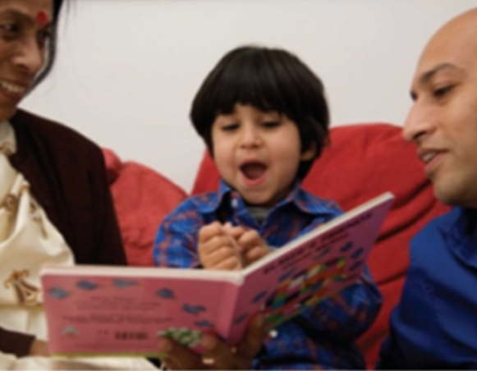
Bookstart is the world’s first national book gifting program
Bookstart was established in 1992 and is run by the reading charity BookTrust.
In 2017, we celebrated 25 years of Bookstart.

Slide 50
Created and administered by BookTrust
BookTrust transforms lives by getting children and families reading
What we do
Encourage and enable parents and others to read regularly to their children
Inspire children and adolescents to read for pleasure
Why we do it
Help children do better at schools and in life
Improve literacy and social mobility
Strengthen the bond between parents and children
How we do it
Build parents’ confidence to read to their children
Give carefully selected books to every child under the age of 5
Give extra support to the most disadvantages children and families
Work with schools and other organizations to get more children reading

Slide 51
Bookstart
Bookstart is built upon a simple premise
Babies who have an early introduction to books benefit emotionally, socially, culturally, and educationally
A love of reading is a gift for life

Slide 52
Bookstart – Targeted products
Bookstart Baby ⇨ Families with children aged 0-12 months
Bookstart Treasure ⇨ Families with children aged 3-4 years
Bookstart Corner ⇨ Packs for children’s centers
Booktouch ⇨ Blind or partially sighted children
Bookshine ⇨ Deaf children
Bookstart Star ⇨ Children who are disabled or delayed in
development of fine motor skills

Slide 53
Lesestart – The German version of Bookstart

Slide 54

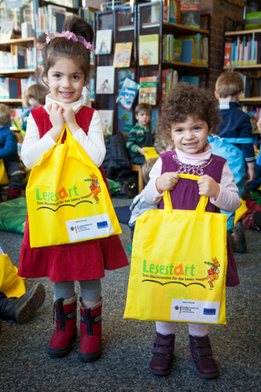

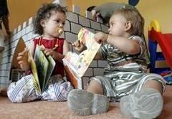

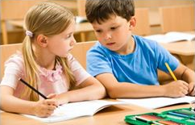
Lesestart – Three reading milestones
Program of the
and Stiftung Lesen for more educational justice right from the outset
Phase 1
Phase 2
Phase 3
Set 1 for one-year-old children
Paediatrician‘s office
Set 2 for three-year-old children
Library
Set 3 for children about to start school
Elementary school
3 x 800,000 Sets 3
3 x 400,000 Sets 1
3 x 400,000 Sets 2
2011
2012
2013
2014
2015
2016
2017
2018

Slide 55
Lesestart – Three reading milestones
Background
Based on the successful British model “Bookstart“ (since 1992)
2006: Launch of “Lesestart“, as a pilot project in the Free State of Saxony
2007: The Free and Hanseatic City of Hamburg was the second federal state to launch “Buchstart – Kinder lieben Bücher” [Children Love Books]
2008-2010: The first national “Lesestart“ initiative in cooperation with the print/paper industry, publishers, and charity organizations (800,000 sets distributed) took place.
Across the country numerous local initiatives have launched individual projects under the “Lesestart“ umbrella.
November 17, 2011: Start of the national initiative “Getting Started – Three Reading Milestones“.

Slide 56
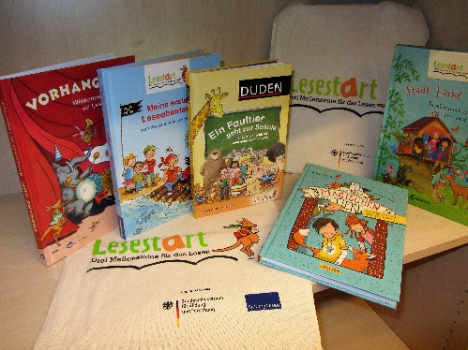
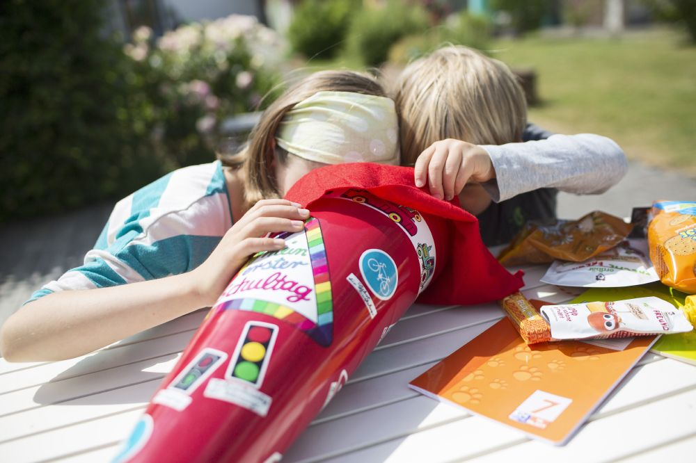
Lesestart – Three reading milestones
Main target group: Children / families ...
living in environments where there is less emphasis on education
where parents seldom or don’t read aloud
Lesestart aims at ...
raising parents’ awareness that reading aloud is an important investment in the development of their children
motivating parents to become active in reading aloud

Slide 57
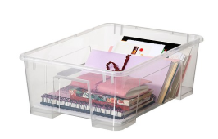
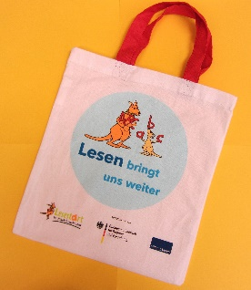
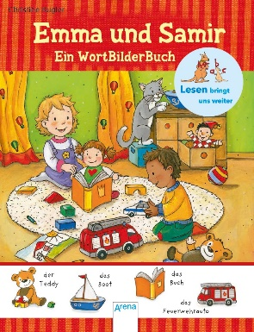
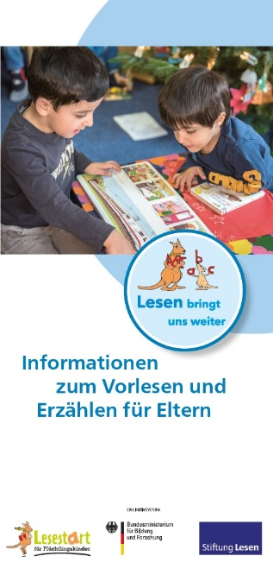
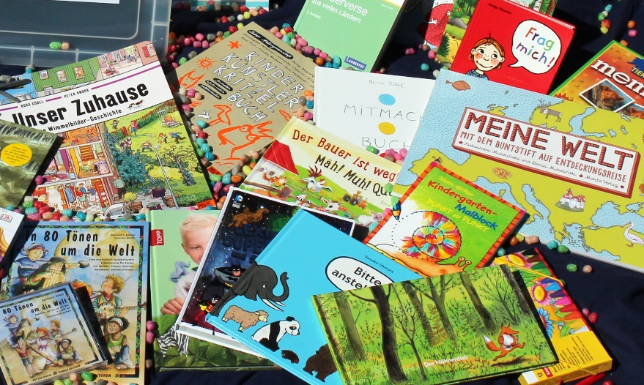
Lesestart for refugee children
Lesestart for refugee children has been adapted from Lesestart – Three reading milestones and meets the needs of refugee centers
The reading box for refugee centers:
Picture dictionaries
Picture books with little text, rhymes etc.
Multilingual books
Books that promote interaction
Comics / mangas
Games
The package – A gift for the families
The bag
The book
The information

Slide 58
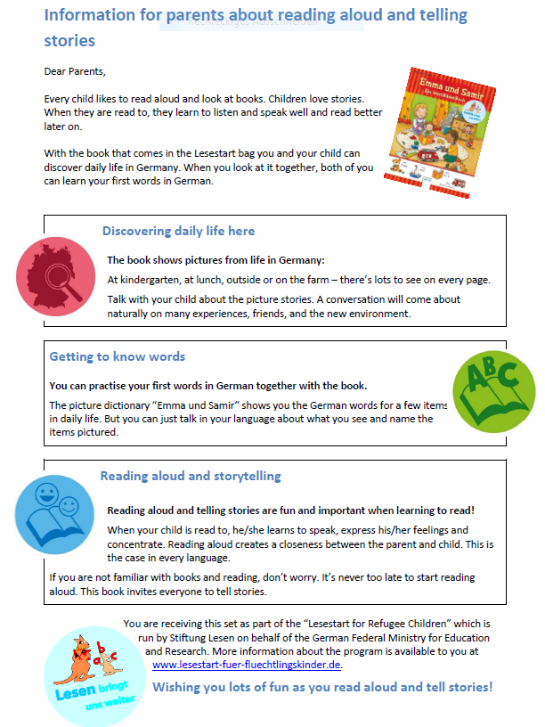
Lesestart for refugee children
The concept
Aim: To introduce refugee children and their families to the concept of reading aloud
Providing material for a playful first approach to the German language
Training multipliers who convey expertise about reading aloud to refugee children: motivating parents to read to their children!
Needs assessment regarding the promotion of reading skills in refugee centers
Connecting refugee centers to reading aloud initiatives in order to set up reading aloud sessions by volunteers
Regular exchange with experts and stakeholders active in refugee aid

Slide 59

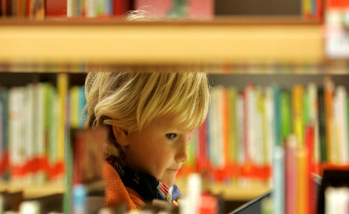
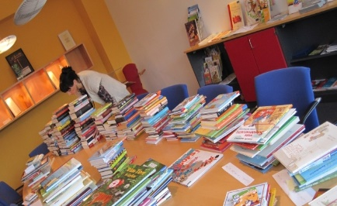
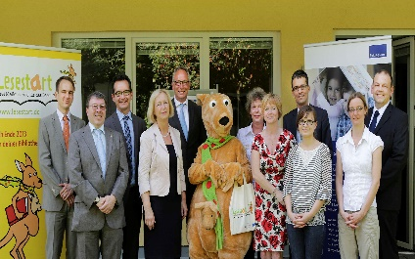
Initiating a growing network
Health insurance companies
Book trade
Library association
with more than 5,000 public libraries
Publishing companies
Paediatric association with more than 5,000 paediatricians
Social organizations
Children‘s book publishers
Foundations
12,000 communities and 350 rural districts
Sozial-,
Bildung,-
Kultus-ministerien
Schools with
more than 35,000 teachers
International reps of communities and institutions
Federal and regional ministries of education
National and regional parents‘ associations
Foundations
Companies

Slide 60
Dr. Simone C. Ehmig
Stiftung Lesen
Roemerwall 40
D-55131 Mainz
+49 6131 28890 81
simone.ehmig@stiftunglesen.de
www.stiftunglesen.de
www.facebook.com/StiftungLesen
www.twitter.com/StiftungLesen

